Slide 1
Marie Program: Ascending/descending Array
Levi Sutton
&
Jonathan Golden

Slide 2
What we did WE do?
Tools Used:
Marie Simulator.
We created a Marie Program to:
Let users enter an array size.
fill the array with Hex values.
print the array as the data was entered.
print the array sorted in descending order.
print the array sorted in ascending order.

Slide 3
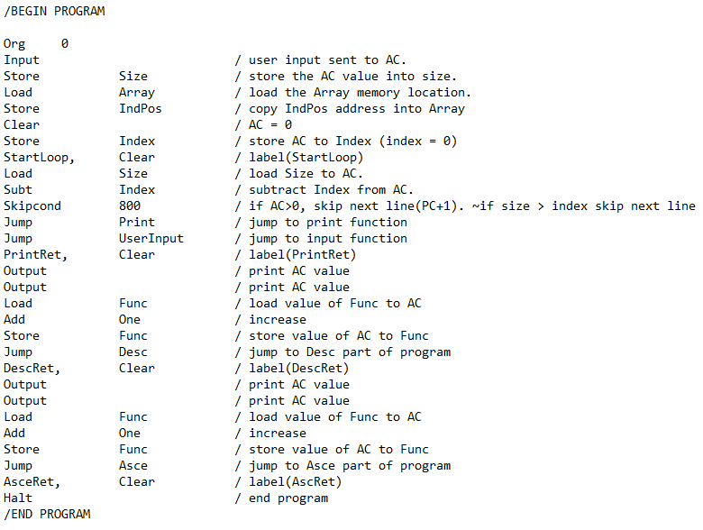
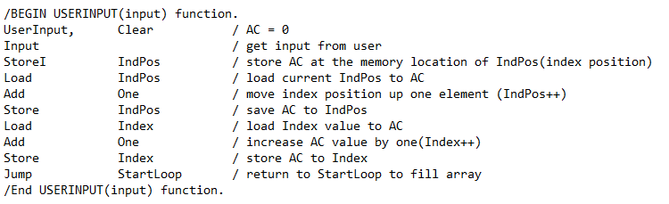
USER input
Function Code for initialiszing array and getting user Input:

Slide 4
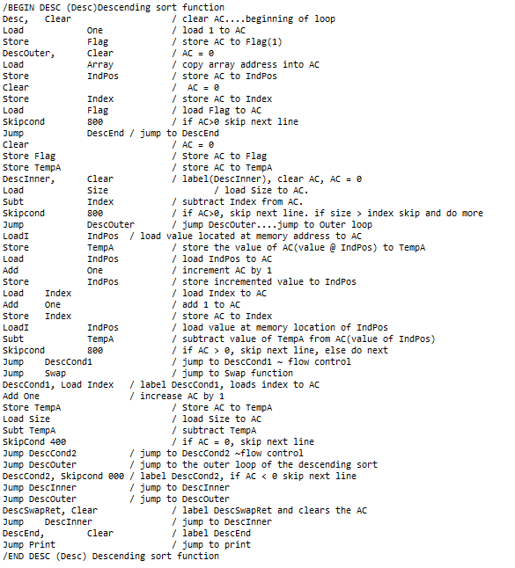
Descending
Function Code for Descending Sort:

Slide 5
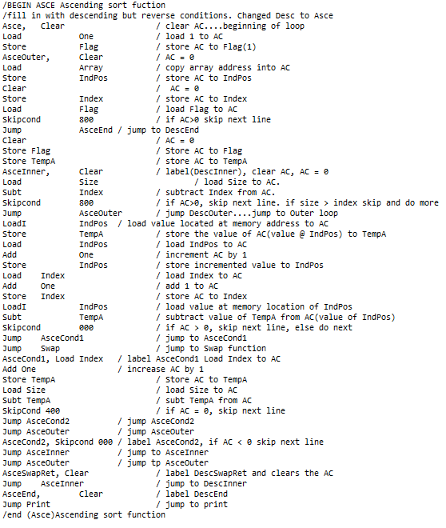
Ascending
Function Code for Ascending Sort:

Slide 6
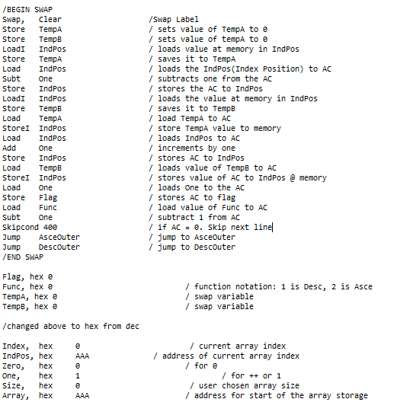
Swap
Function Code for swap function:

Slide 7
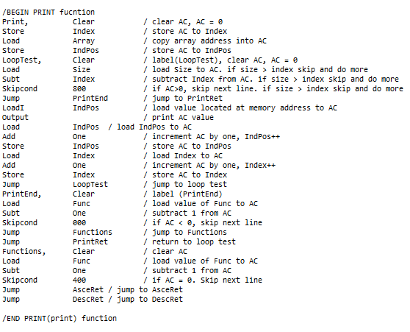
Print Function
Function Code for print function:

Slide 8
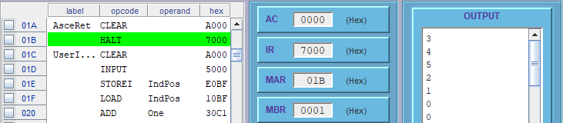

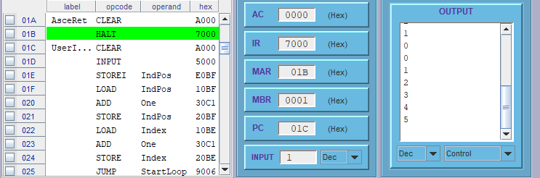
Results
User input:
Descending:
Ascending:

